Slide 1
Презентация для урока английского языка THE WILD TRAP
Государственное бюджетное образовательное учреждение лицей № 623 имени И.П. Павлова
Составитель: Осекова Л.В., учитель английского языка
Санкт-Петербург
2022

Slide 2
ПРЕЗЕНТАЦИЯ «THE WILD TRAP» /«ДИКАЯ ЛОВУШКА» Автор: Осекова Л.В., учитель английского языка лицея № 623
Данная презентация создана в рамках изучения темы: «Литература: «80 дней вокруг света» на уроке английского языка в 10 классе. Учебник: «Английский в фокусе 10», авторы: Вирджиния Эванс, Дженни Дули, Боб Оби, Ольга Афанасьева, Ирина Михеева. Урок № 59 по рабочей программе.
В презентации зафиксированы эпизоды из мультфильма “Around the World in 80 Days”. Данная презентация может быть использована в качестве наглядного пособия на уроке, а также для представления на английском языке на сцене школьного театра.

Slide 3
The Wild Trap

Slide 4
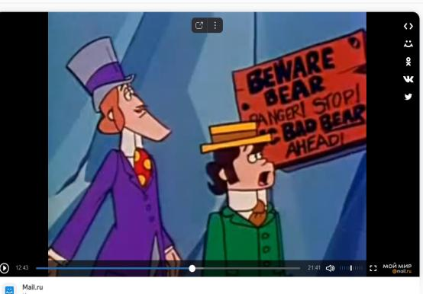
Episode 1
Passepartout and Mr Fogg see a bear.

Slide 5
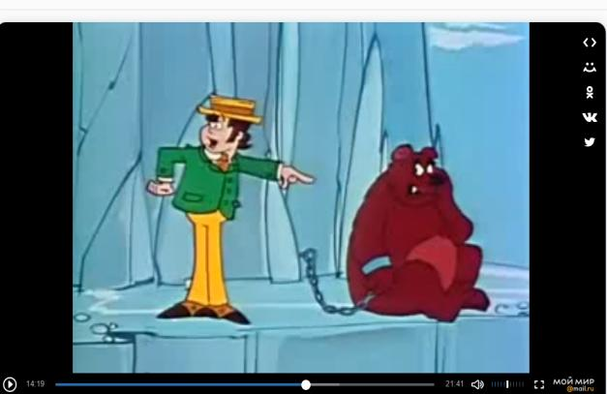
Episode 2
P: Fix tricks! I bet it's monsieur Fix in disguise. It's a Fix's trick, for sure.

Slide 6
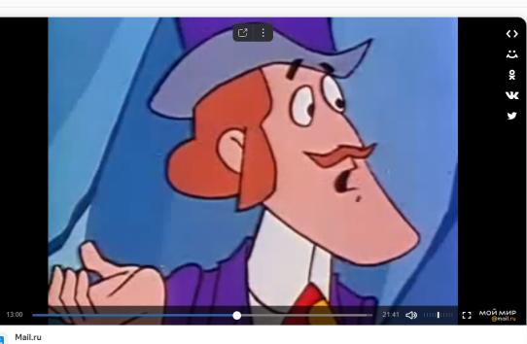
Episode 3
FF: He looks like a bear to me, Passpartout.

Slide 7
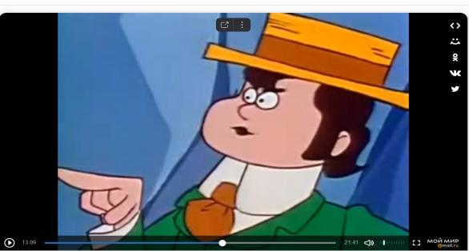
Episode 4
P: No, no, you're not suspicious enough. That Fix is very tricky. I'll prove it to you.

Slide 8
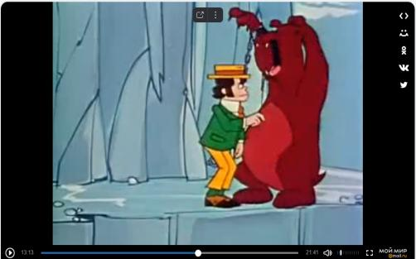
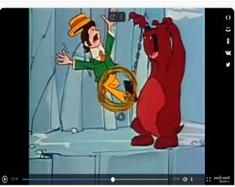
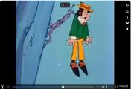
Episode 5+6
Passepartout
faces
a real bear!

Slide 9
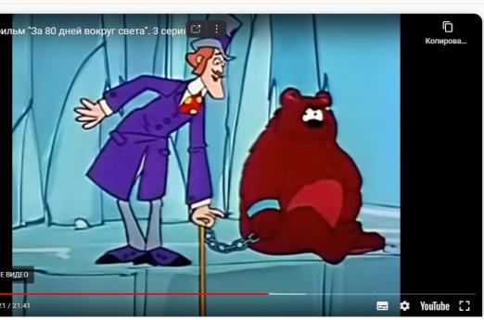
Episode 7
FF: Take hold of my walking stick.

Slide 10
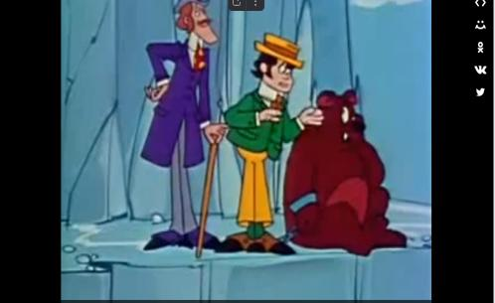
Episode 8
P: Here! Go away, bear! Shu! Shu!
(The bear is growling.)

Slide 11
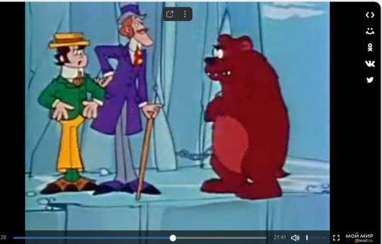
Episode 9
P: We cannot stop. We are to go around the world in 80 days, so Fogg can marry Belinda Maze. Get out of the way!
- He won't go!
- Maybe there is something in the bag!

Slide 12
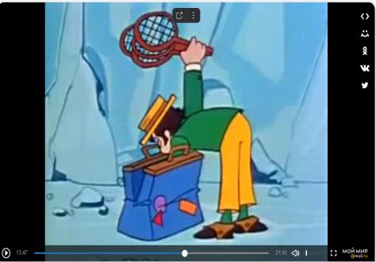
Episode 10
- We could cage him! No, you cannot make a cage out of tennis rackets.

Slide 13
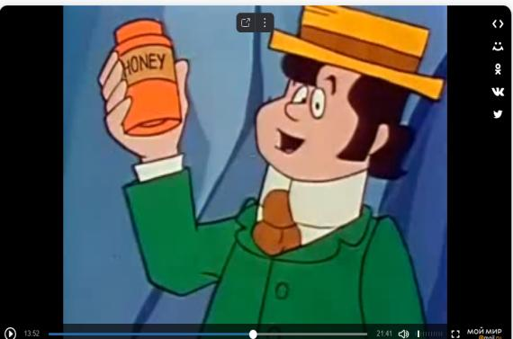
Episode 11
This honey?

Slide 14
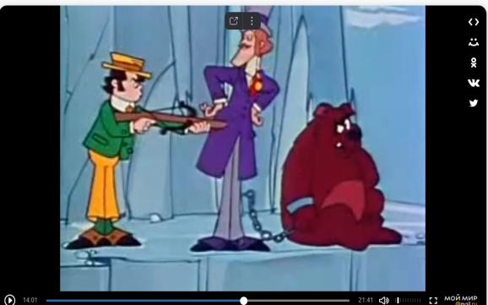
Episode 12
- Aha! A crossbow! We'll shoot him!

Slide 15
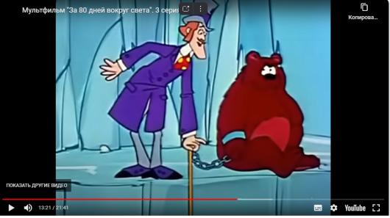
Episode 13
FF: No, no, we do not shoot things. We must protect wild lives, Passepartout. Besides, it's not his fault. I suspect, Mr Fix tied him there. Now we must make friends with him.

Slide 16
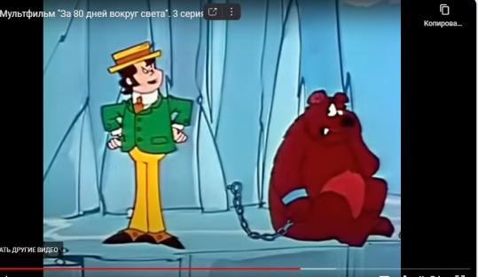
Episode 14
P: He doesn't seem very friendly to me! That's a very very angry bear. There is no way to make friends with him.

Slide 17
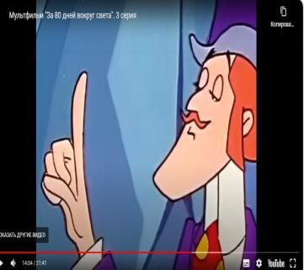
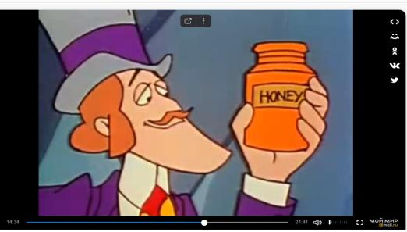
Episode 15
FF: There is always a way to save the day.
the honey
Pot!
We'll use…
the honey pot

Slide 18
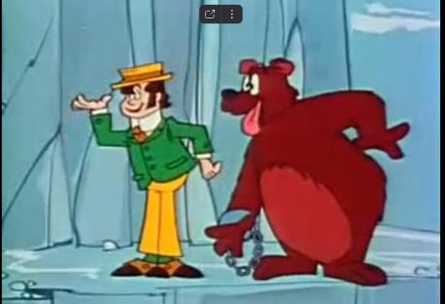
Episode 16
P: Parlez-vous! Of course – the honey! Why did I not think of that?

Slide 19
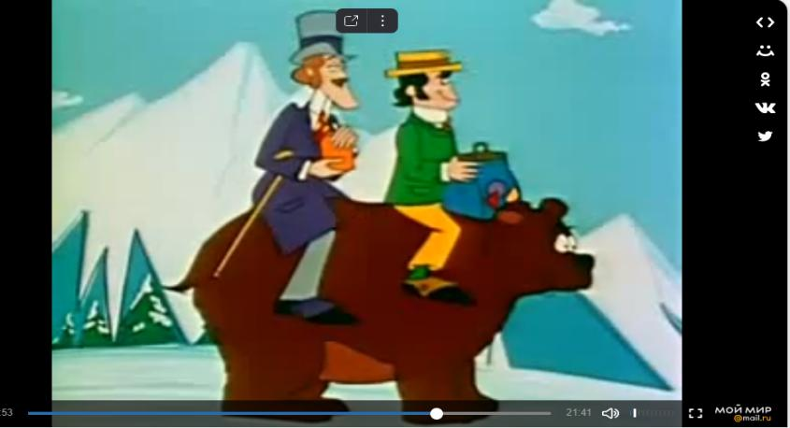
Thus Mr Filias Fogg and Passepartout made friends with a wild bear.
Episode
17

Slide 20
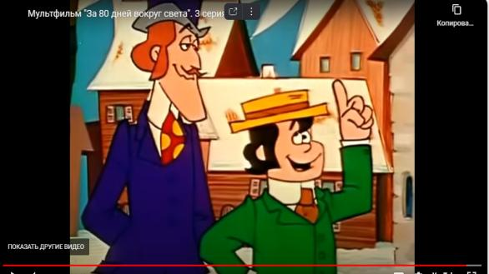
The end.
FF: There is always a way to save the day.

